Slide 1
BEER DATA SCIENCE PROJECT

Slide 2
INTRODUCTION TO THE DATA
Data Source : https://drive.google.com/open?id=1e-kyoB97a5tnE7X4T4Es4FHi4g6Trefq
Number of Observations: 528870
Number of columns : 14

Slide 3
Description of the Variables
Variable Name | Type
beer_ABV(Alcohol by Volume) | Numeric
beer_beerId | Integer
beer_brewerId | Integer
beer_name | Character
beer_style | Character
review_appearance | Numeric
review_palette | Numeric
review_overall | Numeric
review_taste | Numeric
review_profileName | Character
review_aroma | Numeric
review_text | Character
review_time | Integer(Unix time Stamp)

Slide 4
Unique Variables
Number of Unique Breweries : 1803
Number of Unique Beer IDs : 20200
Number of Unique Beer Styles : 104

Slide 5
Missing Values
Total Number of Observations | 528870
Total Number of Missing Values | 20280
Column with missing value | beer_ABV
Percentage of Missing values | 4%

Slide 6
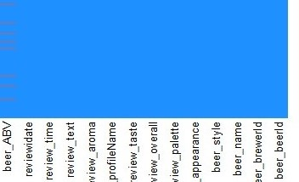
Missing values graph

Slide 7
Top Breweries with strongest Beers
Question #1

Slide 8
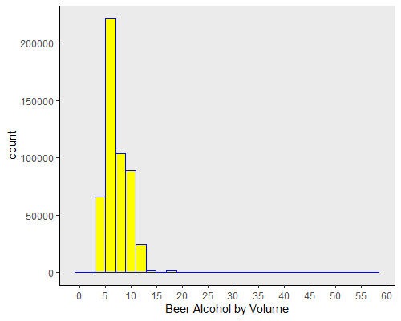
Distribution of Beer Alcohol by volume

Slide 9
Top 3 Breweries
Brewer Id | Mean ABV
6513 | 47.9
35 | 27
16866 | 19.5
4% of the observations with missing beer ABV values are removed from the analysis.
The range of beer ABV differs from one Brewery to another.
Mean ABV is obtained to pick the top breweries.

Slide 10
Year with Highest Ratings
Question #2

Slide 11
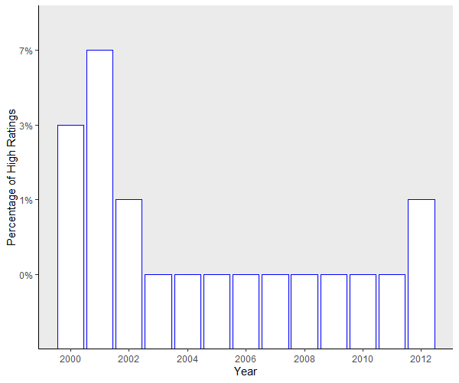
High Ratings by Year

Slide 12
Conclusion for the year with highest Ratings
The data has ratings from 1998 to 2012.
The total number of reviews increased every year.
Even though 2011 has most of number of reviews with high ratings, it is not at the top by the percentage of positive ratings.
Year 2001 has the highest percentage of positive ratings.

Slide 13
Correlation between Review Ratings
Question # 3

Slide 14
Correlation between Reviews
 | Appearance | Palette | Aroma | Taste | Overall
Appearance | 1 | 0.55 | 0.53 | 0.55 | 0.49
Palette | 0.55 | 1 | 0.71 | 0.6 | 0.6
Aroma | 0.53 | 0.71 | 1 | 0.73 | 0.78
Taste | 0.55 | 0.6 | 0.73 | 1 | 0.69
Overall | 0.49 | 0.6 | 0.78 | 0.69 | 1

Slide 15
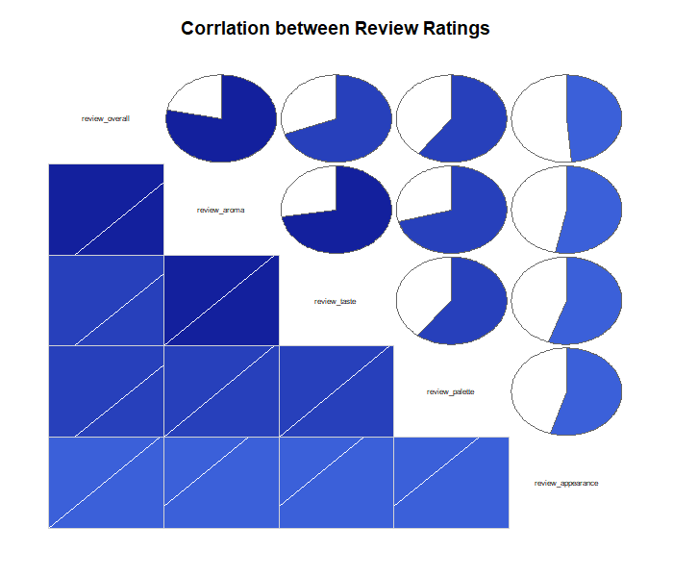
Correlation Graph

Slide 16
Conclusion about correlation
There is very strong correlation between overall review and Aroma review.
Taste also high correlation with over all review.
Taste and Aroma are also correlated.
Appearance has the least correlation with overall review.
Taste and Aroma are very important factors.

Slide 17
Top 3 Beer Names
Question # 4

Slide 18
Observations by ABV Group
ABV Group | Number of Observations | Percentage of Observations
Less than 10 | 463236 | 91.08%
Between 10 and 20 | 44919 | 8.83%
Between 20 and 30 | 428 | 0.08%
Between 30 and 40 | 4 | 0.00%
Greater than 40 | 3 | 0.00%

Slide 19
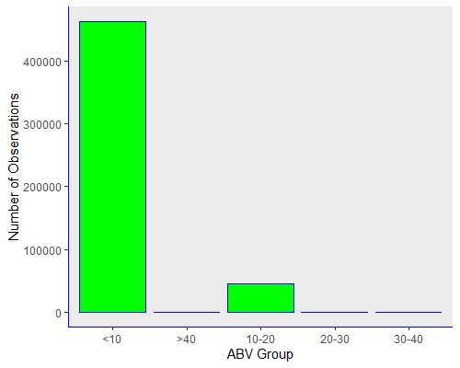
Number of Observations by ABV Group

Slide 20
Top 10 Beers with high number of Reviews
Beer Name | Number of Reviews
Sierra Nevada Celebration Ale | 3000
Sierra Nevada Pale Ale | 2587
Founders Breakfast Stout | 2502
Sierra Nevada Bigfoot Barleywine Style Ale | 2492
La Fin Du Monde | 2483
Samuel Adams Boston Lager | 2418
Chocolate Stout | 2234
Dead Guy Ale | 2234
Trappistes Rochefort 10 | 2170
Sierra Nevada Torpedo Extra IPA | 2029

Slide 21
Top Beers with High Ratings and high Reviews
Beer Name | Average Overall Review | Number of Reviews
Founders Breakfast Stout | 4.35 | 2502
Trappistes Rochefort 10 | 4.34 | 2170
La Fin Du Monde | 4.30 | 2483
Sierra Nevada Pale Ale | 4.25 | 2587
Sierra Nevada Celebration Ale | 4.17 | 3000
Sierra Nevada Torpedo Extra IPA | 4.10 | 2029
Dead Guy Ale | 4.04 | 2234
Samuel Adams Boston Lager | 4.04 | 2418
Chocolate Stout | 4.02 | 2234
Sierra Nevada Bigfoot Barleywine Style Ale | 3.97 | 2492

Slide 22
Top 3 Recommended Beers
Beer Name | Average Overall Review | Number of Reviews
Founders Breakfast Stout | 4.35 | 2502
Trappistes Rochefort 10 | 4.34 | 2170
La Fin Du Monde | 4.30 | 2483

Slide 23
Conclusion about top 3 Beers
About 90% of the observations have ABV less than 20%
Out of this 90%, Beer with most reviews are selected.
Then Beers with most reviews and high ratings are deduced to select top 3 Beers.

Slide 24
Top beer Style
Question #5

Slide 25
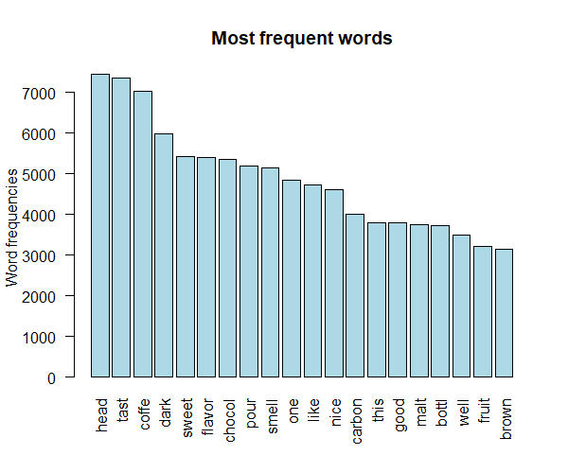
Most frequently used words in Top Beers Reviews

Slide 26
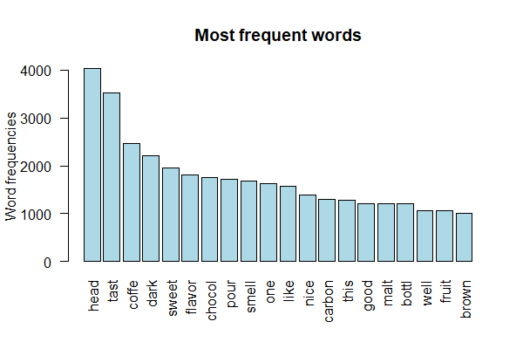
Most frequently used words in Low Rated Beers

Slide 27
Top 3 Beer Styles
Beer Style | Mean Review
American Double / Imperial Stout | 4.35
Quadrupel (Quad) | 4.34
Tripel | 4.30

Slide 28
Challenges in Text Mining
The most frequently used words in the top rated beer are graphed
The most frequently used in the low rated beer are graphed.
There are some common words in both categories.
It will be hard to correlate the review ratings with the text reviews.
Review overall is used to get top 3 beer styles

